Slide 1
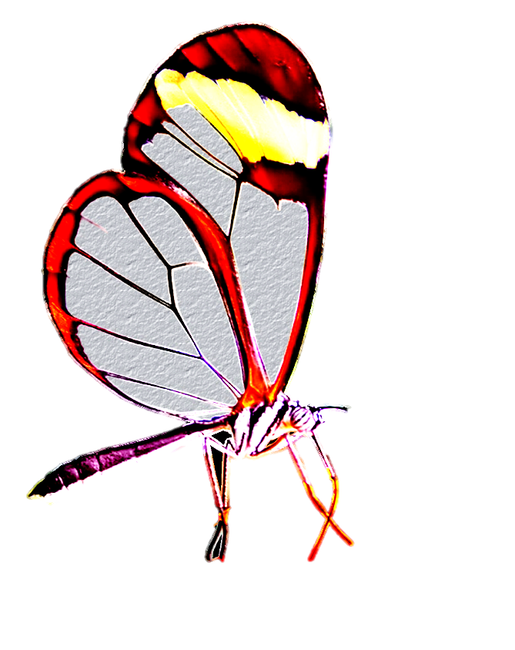
Dermafill® by Paradigm Medical
Nature’s way of healing wounds!
Reduces healing time
Controls pain
Bacteriostatic
Single-application
Transparent dressing
No secondary dressing required
Easy to apply
Cost-effective

Slide 2
What is Dermafill and how does it work?
Dermafill is a translucent, semi-opaque biosynthetic cellulose membrane dressing, which at a microscopic level, closely resembles the body's own collagen. The nonwoven ribbons of microbial cellulose closely resemble the body’s extracellular matrix, yielding a high vapor transfer rate while providing a normal covering for the wound bed. The result is a fluid balance and mechanical cellular matrix which bridges the wound bed and promotes distribution and concentration of growth factors and nutrients needed for healing, while protecting the wound from environmental contamination.

Slide 3
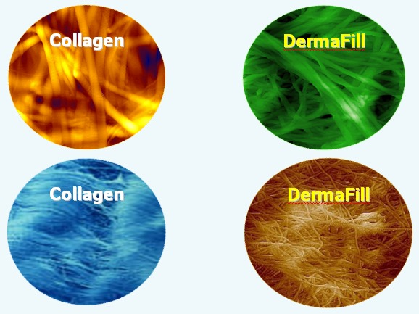
The electron microscopy below demonstrates how microbial cellulose is nearly identical to the body’s own tissue. The spaghetti-like network of fibers found in our collagen is indistinguishable from the microbial cellulose found in Dermafill. It is for this reason that Dermafill exhibits its exclusive properties and works unlike any other dressing. Microbial cellulose creates a scaffold like the body’s own tissue which allows for the migration of healing cells across the entire bed of the wound. The unique structure also has a pore size equal to the skin assuring proper moisture content in the wound while allowing oxygen to penetrate the dressing at the same time as it protects the wound from bacteria.

Slide 4
Dermafill Indications
Pressure ulcers
Venous ulcers
Diabetic and neuropathic ulcers
Burns
Skin tears
Chronic vascular ulcers
Traumatic injuries, including abrasions and lacerations
Donor graft sites
Minor surgical and cosmetic wounds
Wound Dehiscence

Slide 5
Dermafill Contraindications and Precautions
Dermafill is not indicated for 1st and 3rd degree burns and will not adhere to a dry surface.
Dermafill should not be applied until excessive exudate and infection are controlled.
Do not re-use or re-sterilize once Dermafill has been applied to the wound.
Do not use if package seal is broken or membrane shows evidence of contamination or damage.

Slide 6
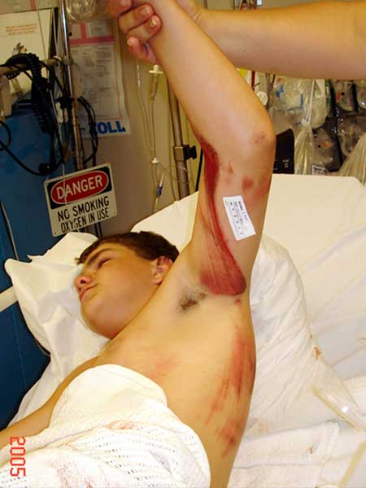
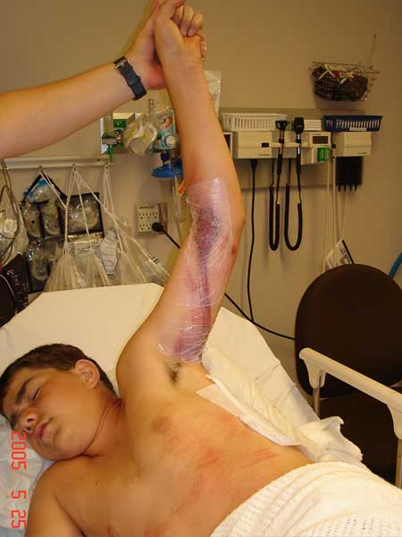
Road Rash
Instant pain relief allowed patient to relax
Arm moistened with saline prior to application
allowing Dermafill to adhere to damaged tissue

Slide 7
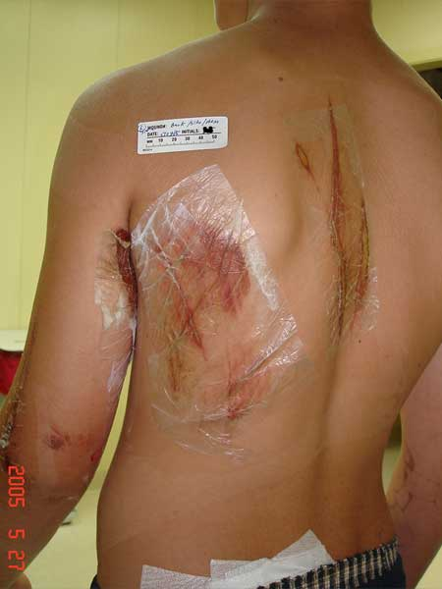
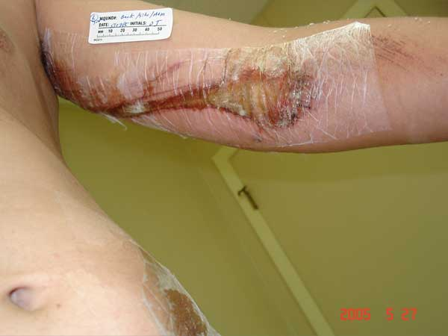
Dermafill Day 2
Note areas not apparently injured where Dermafill adhered at this point
Patient showering
Scab formation under dressing more yellow in color and only dark where bleeding was present

Slide 8
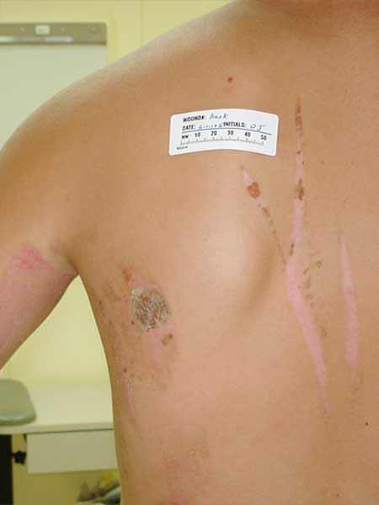
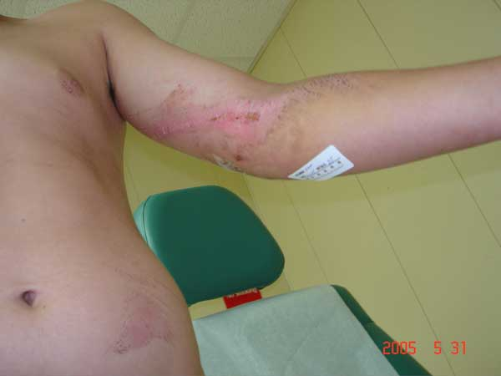
Day 6
Wounds healed
Note patchwork pattern where dressing
simply fell off on healed areas
Single application
Pain free

Slide 9
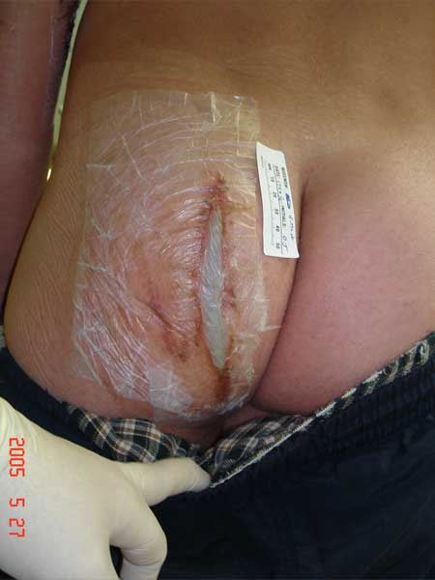
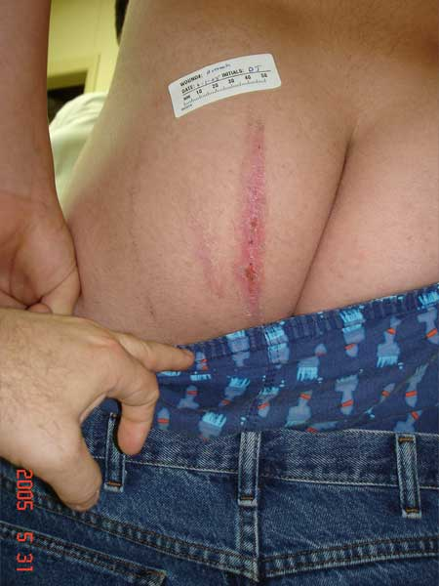
Day 2/Day 6
Wound healed
Dressing simply fell off when healed
Single application
Pain free
Dermafill is sealed and it has also attached itself to the adjacent damaged tissue
At this point, showering was not recommended, though patient did shower and dressing remained in place

Slide 10
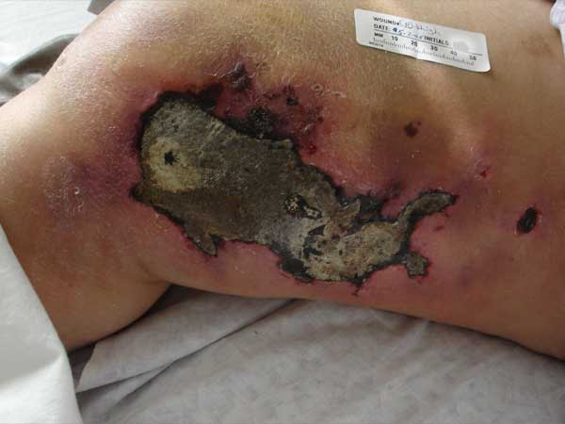
60 Y/O Female – Run Over By Jeep
Patient developed compartment syndrome. Progressed to necrotizing fasciitis. Mixed culture Strep A and MRSA.

Slide 11
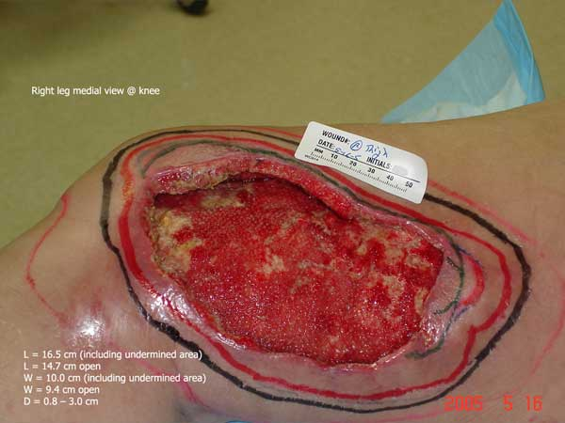
Day 1 Before Dermafill
Wound treated with surgical debridements, culture specific IV antibiotics and Wound VAC.

Slide 12
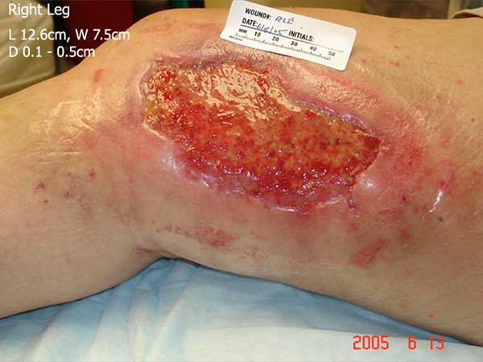
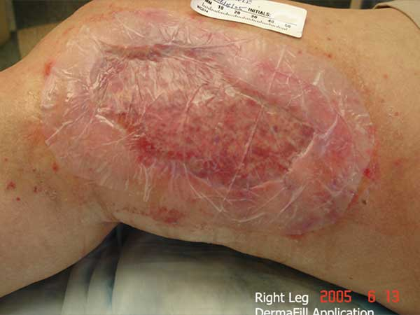
Day 1 Dermafill
Undermining successfully treated.
Dermafill applied 6-13-05. Clearly allows unobstructed view of healing process.

Slide 13
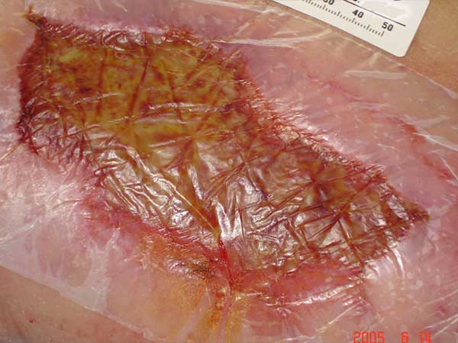
Day 2 Dermafill
Sealed to wound and damaged tissue only (including damaged peri-wound area).
No adhesive used.
No Pain.

Slide 14
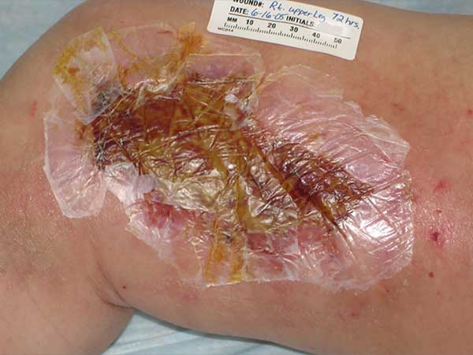
Day 4 Dermafill
Cracks at stress points patched.
No signs and symptoms of infection.
No Pain.

Slide 15
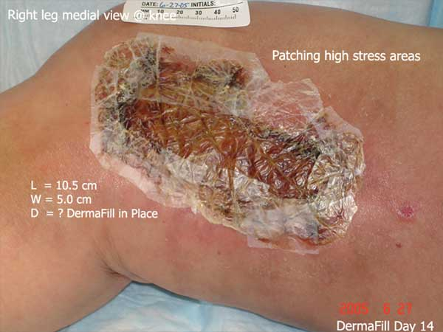
Day 14 Dermafill
No daily dressing change(s).
Patient showers daily.
No signs and symptoms of infection.
Patches present on high stress areas applied by patient at home.

Slide 16
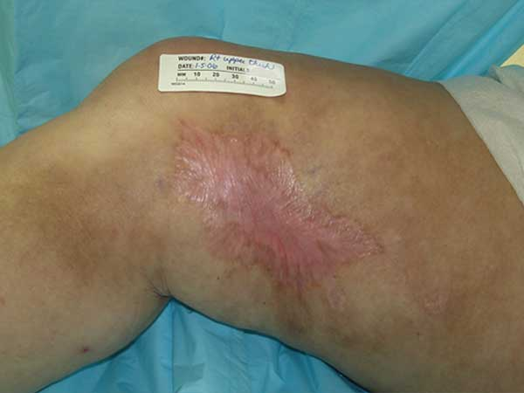
Dermafill 6 Month Follow-up
Dressing changed once after application.
Patient enjoyed pain free healing without any inconvenience of daily dressing change(s).

Slide 17
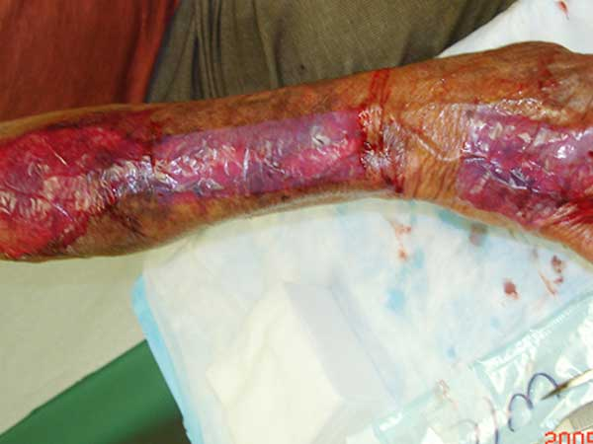
72 Y/O Male – De-gloved Arm
De-gloved arm in farm accident.
Dermafill placed over wound stopping pain and bleeding.
Patient requested Dermafill be covered with a secondary wound dressing as he would be covered by dirt and mud by the end of each work day.

Slide 18
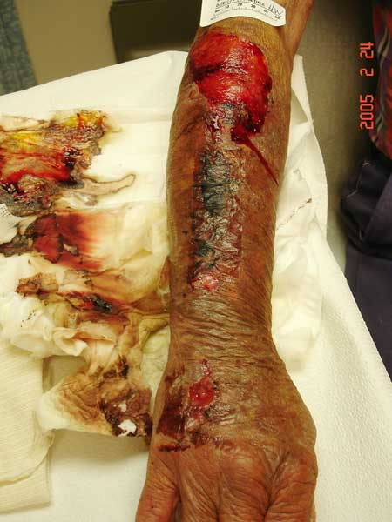
Day 3
Where Dermafill remained wet from sweat, the dressing fell off when the cast padding was removed.
Dermafill was re-applied at the patient’s request.
Patient agreed to allow dressing to set up for 24 hours before returning to work.

Slide 19
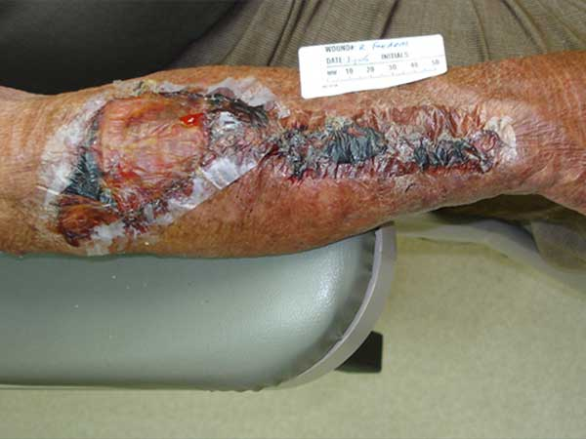
Day 8
Dermafill remained in place. Patient patched dressing when it cracked.
Dermafill remained clear. The darker areas are where bleeding occurred.
Even in harsh environment, dressing prevented infection.

Slide 20
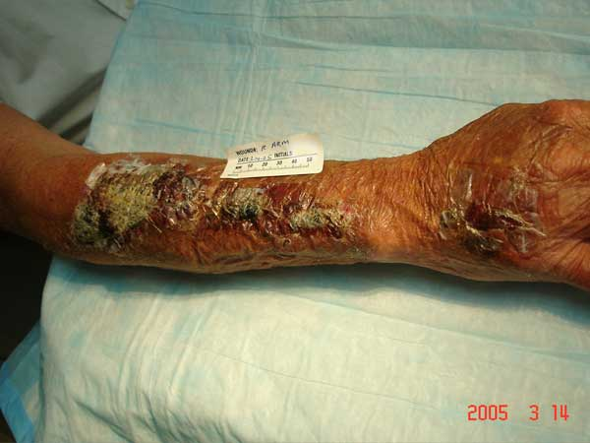
Day 21
Dermafill remained in place.
Patient showering and working in fields for last 2 weeks.

Slide 21
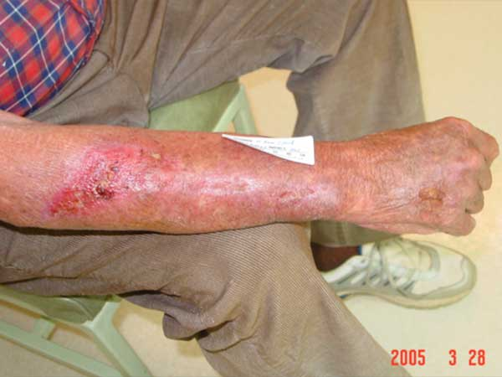
Day 28
Patient nearly completely epithelialized.
Dermafill simply falls off as tissue heals.

Slide 22
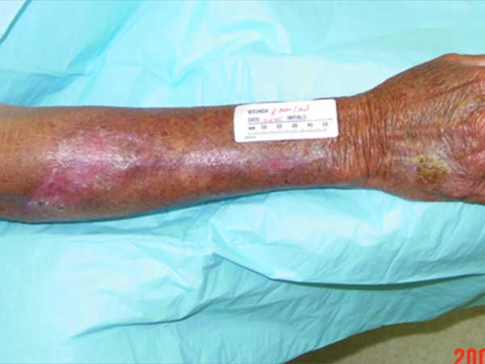
7 Week Follow-up
Wound completely closed at 7 week follow-up.
Patient required one dressing change over course of therapy.
No pain and cared for wound at home. One prophylactic course of antibiotics.

Slide 23
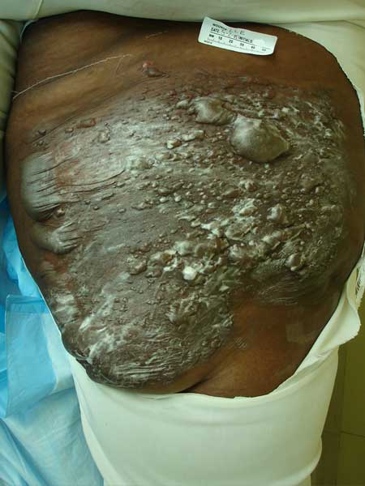
34 Y/O Female – Grease Burn
Morbidly obese, with a history of: Type II Diabetes, Asthma, CHF, Lymphedema, and poorly controlled hypertension.
Patient presented with 2nd and 3rd degree burns on inner thigh measuring 29x39cm.

Slide 24
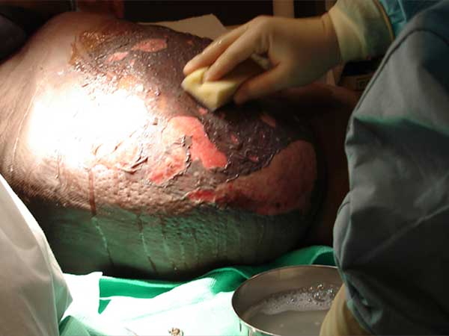
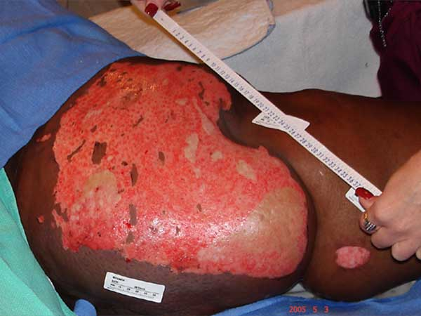
Day 2
Patient’s wound surgically debrided.
Wound debrided in operating room revealing 2nd and 3rd degree burns.

Slide 25
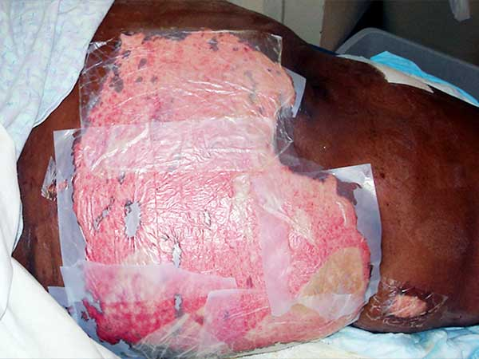
Day 2 Dermafill
Dermafill applied to wound and overlapped as wound is larger than dressing size creating one seamless dressing.

Slide 26
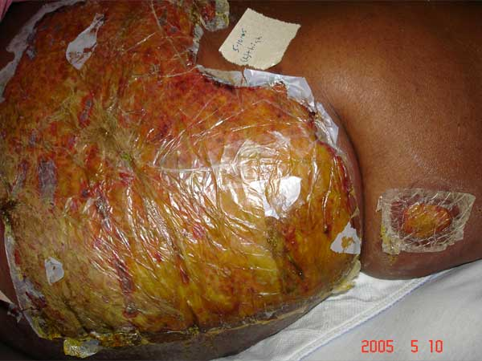
Day 6 Dermafill
Dermafill is securely attached to wound bed.
Patient remains pain free and free of signs and symptoms of infection.
Dressing patched if it cracks.

Slide 27
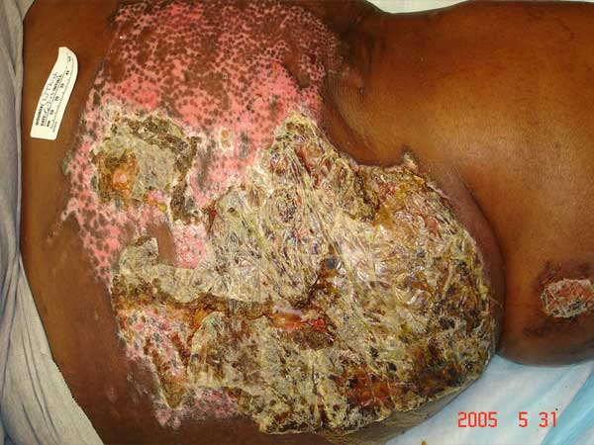
Day 27 Dermafill
Patient has been at home for 2 weeks caring for self.
Patient showers and remains pain free.
NOTE: Patchwork pattern as Dermafill flakes off wherever underlying tissue is healed, even in the middle of the wound.

Slide 28
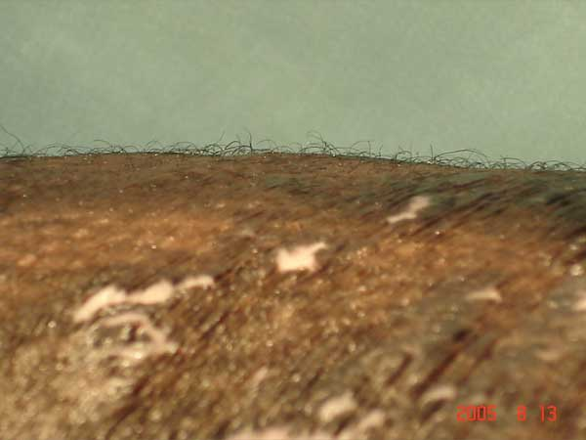
3 Months
Hair is present over previously burned tissue at 3 months

Slide 29
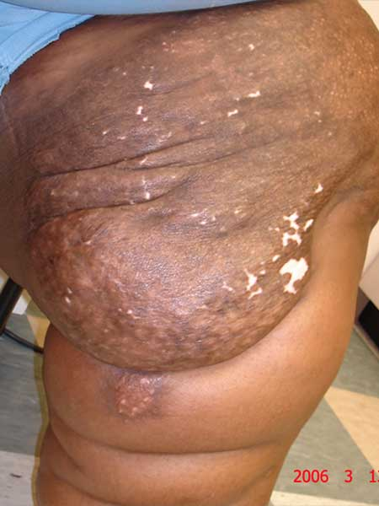
10 Months (Follow-up)
Patient healed with excellent form and function with 1 dressing change.
Pain-free course of therapy with excellent cosmetic result.
Patient thrilled with results.

Slide 30
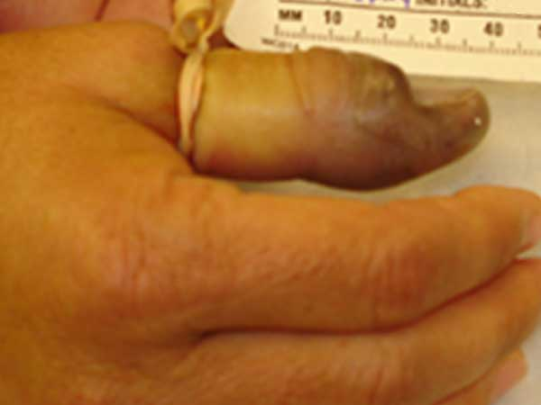
44 Y/O Female – Water Moccasin Bite
Water Moccasin Bite on thumb.
Otherwise healthy patient.

Slide 31
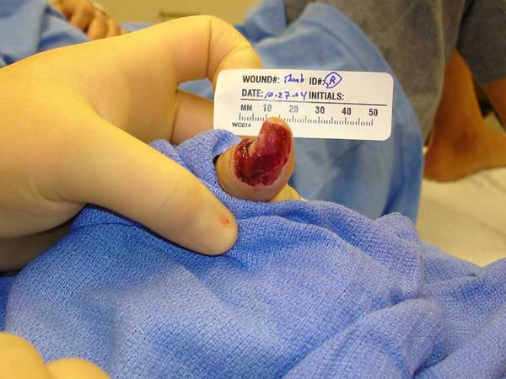
Day 1
Necrotic tissue debrided to the bone under local anesthesia.
Dermafill later applied.

Slide 32
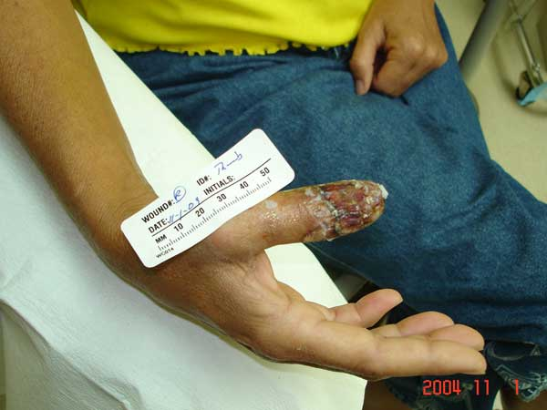
Day 3 Dermafill
Dermafill in place for 72hrs.
Patient pain-free.
No secondary dressing required.
One course of antibiotics ordered.

Slide 33
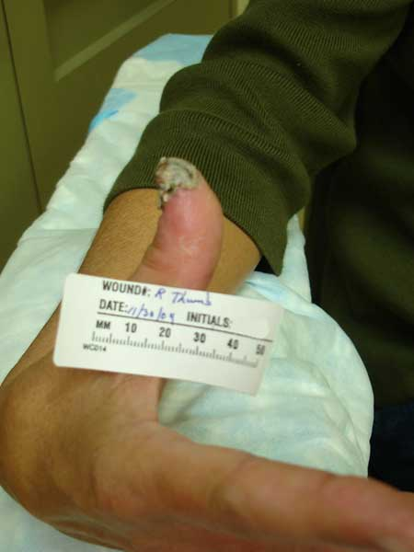
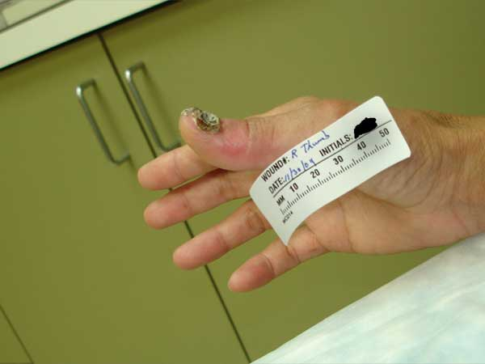
Day 32 Dermafill
Single-application.
Soft tissue repaired.
Dressing still attached to nail bed.

Slide 34
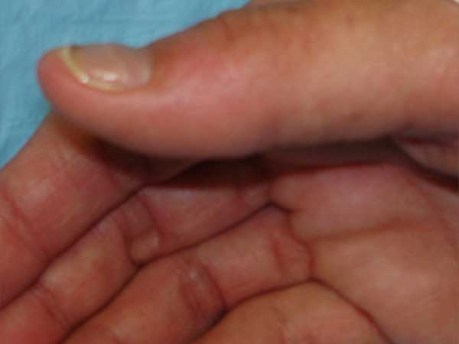
4 Month Follow-up
Soft tissue healed scar free.
Nail healed.
Single-application and pain-free recovery.

Slide 35
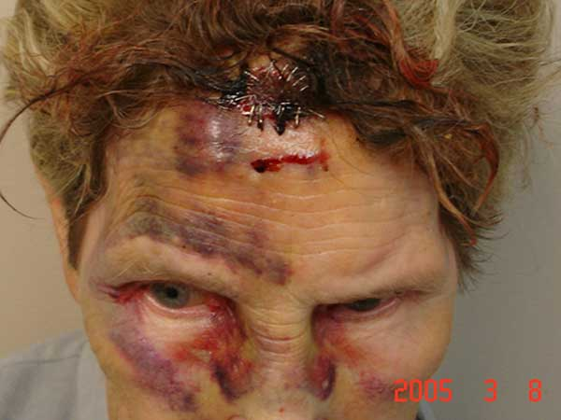
81 Y/O Female
Ischemic irradiated wound.
Patient received 7000cGy (centigrade) radiation for throat cancer 6 months prior.
Patient fell, injuring face and scalp.

Slide 36
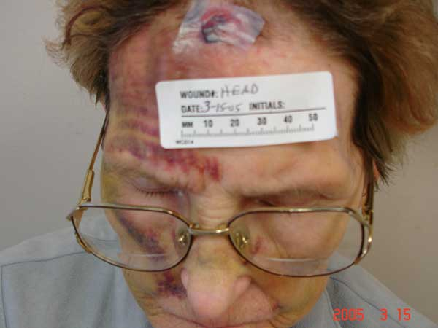
Day 10 Dermafill
10 day follow-up.
Dermafill applied.

Slide 37
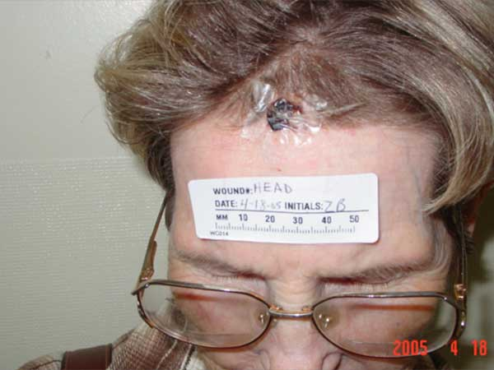
Day 44
Dermafill remains in place.
Wound healing.

Slide 38
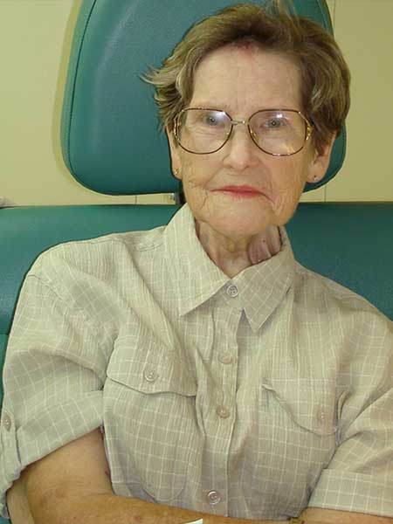
5 Month Follow-up
Single-application
Pain Free

Slide 39
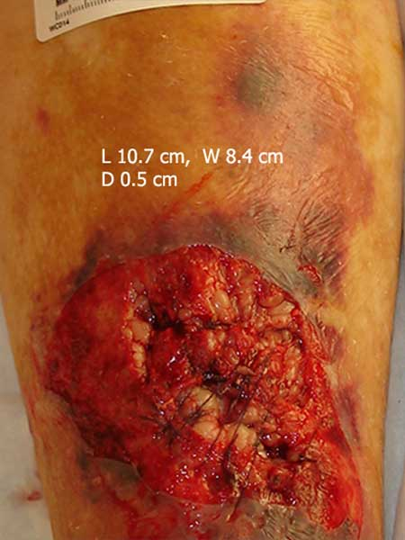
92 Y/O Female – Non-Healing Wound
Non-healing traumatic wound.
Measures 10.7cm x 8.4cm, depth to bone.
Hx: Leg varicosities with ulcers, bone and cartilage disorder, hypoxemia and cardiac disease, PVD, long term coumadin therapy.
Wound painful and prevented exercise and rehab.
Subject at risk of infection.

Slide 40
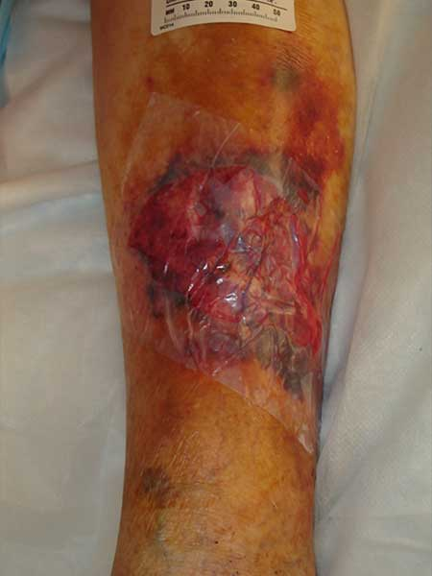
Day 1
Wound open 3 weeks prior to Dermafill application.
Patient had been receiving painful dressing changes 6-8 times daily.
Dermafill applied, bleeding and pain ceased.

Slide 41
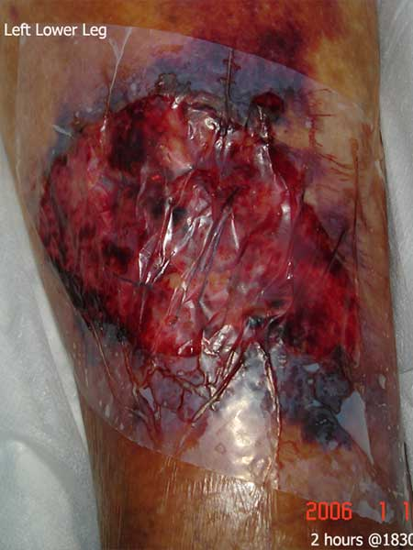
2 Hours
Dressing sealed securely in place.

Slide 42
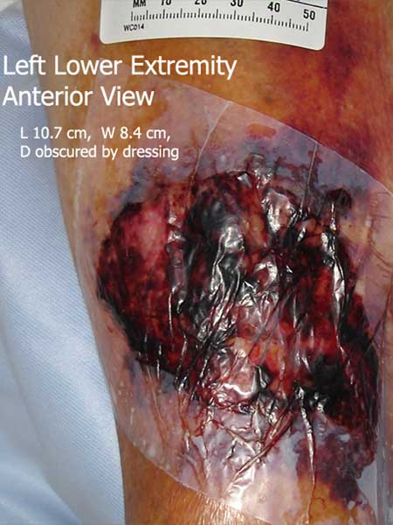
16 Hours
Within 16 hours of Dermafill application, patient ambulating and receiving physical therapy.
No need for secondary dressing or pain medication.

Slide 43
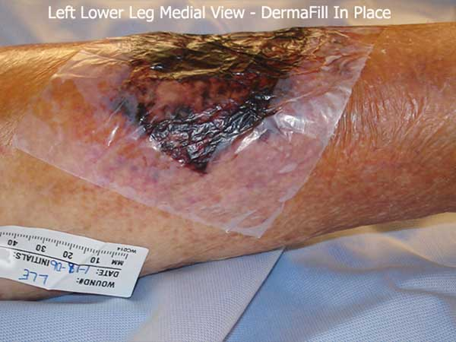
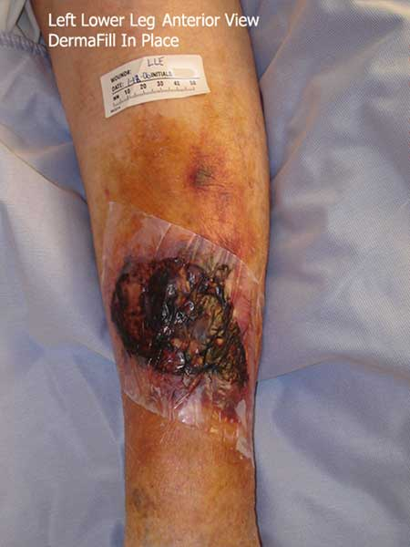
Day 2
Dressing adheres to wound and not surrounding tissue.
High vapor transfer rate prevents maceration of tissue.
Patient discharged within 40 hours of Dermafill application.
Single application, pain-free post application, bleeding stopped, infection prevented.

Slide 44
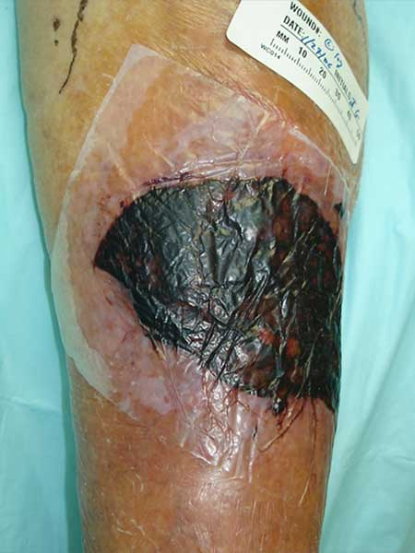
Day 10
Dressing securely in place at 10 Days.
Patient at home showering.

Slide 45
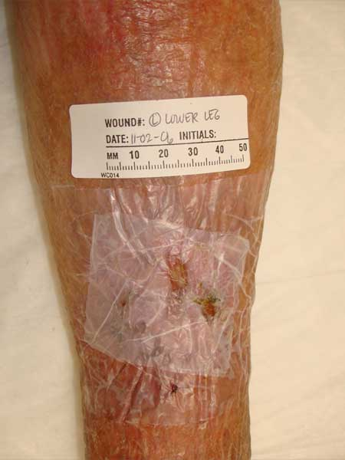
6 Month Follow-Up
Patient healed original wound, but fell and reinjured previously damaged area.
Family used Dermafill given for patching on 2 new skin tears acquired 10 days earlier.

Slide 46

75 Y/O Female
Wound to bridge of nose, bone involvement.
Hx. of hypertension, CAD, 2 pack/day smoker.
Patient noted pain relief with application of Dermafill.
Requested steri-strip be placed at edges for glasses to rest on.
Dermafill at 7 days.

Slide 47

Day 14
Dressing fell off painlessly.
Single application.
No scar.

Slide 48

61 Y/O Male
Ischemic wound from horse trailer injury.
ABI .40, Transcutaneous Oxygen Pressure (TCP02) 25.
Patient treated for 3 weeks prior to being seen at wound center.

Slide 49

Day 15
Patient received serial debridements, culture specific antibiotics, and wound dressed with silver dressing for 21 days.
Pain 8 on scale of 1-10.

Slide 50

Day 21
Dermafill applied on day 21.
Patient noted immediate pain relief with pain registering at a 0 on a scale of 0 to 10.

Slide 51

Day 8 Dermafill
Patient showering with Dermafill in place over wound.
Single-application and pain-free since Dermafill application.

Slide 52

37 Y/O Female – 2nd Degree Burn
Patient presented with 2nd degree burns on face.
Dermafill dressing in place.

Slide 53

Day 4
Dermafill lifted off face in 4 days.
Patient states once dressing was applied, she became pain-free and remained so throughout recovery.

Slide 54


3 Month Follow-up
No scarring present.
Patient stated that left side of face (burned side) appeared “More youthful.”

Slide 55

Miller
Multiple myeloma and painful bilateral vasculitic wounds.
10 out of 10 on pain scale.
Patient claimed nearly instant pain relief upon application of dressing.

Slide 56

Day 7
Dermafill dressing adhered to wound.
Patient remains pain-free.

Slide 57

2 Months
Dermafill removed revealing granular healing tissue.
Dermafill re-applied.

Slide 58

Day 1 Re-Application

Slide 59

Day 7 Re-Application

Slide 60

2 Months Re-Application

Slide 61

2 Leg Comparison
Dermafill dressing appears dry, however, moist wound environment is maintained.

Slide 62

7 Month Follow-up

Slide 63

99 ½ Y/O Female
Patient fell, forming hematoma, Cerebral Ischemia,
Multiple Transient Ischemic Attacks (TIA)
Coumadin Therapy and Coronary Artery Disease (CAD)

Slide 64

Day 1
Hematoma evacuated, revealing exposed bone.

Slide 65

Day 19
Dermafill placed over wound.

Slide 66

Day 23
Hair pushing Dermafill off healed wound bed.
Single application/Pain-free.

Slide 67

82 Y/O Male – Car Accident
Patient went through windshield in car accident and landed on asphalt.
Broken bones and contusions required extended hospitalization.
De-gloved left hand with tendon involvement.

Slide 68

Day 1
Wound cleaned and Dermafill placed on wound in ER.
Bleeding stopped and pain relief came with Dermafill application.
Patient refused to have ring removed.

Slide 69

Day 4
Dressing in place and ring loose.
Mobility in fingers.
Patient continues to state hand is pain free.

Slide 70

Day 7
Dermafill removed by staff, fearing underlying exudate was an infection.
Note: Lack of signs and symptoms of infection and clean, granular wound bed.

Slide 71

Day 9
Dressing replaced for 48hrs.
Note: Plasma and other bioactive agents accumulate under dressing.

Slide 72

Day 12
The dressing is re-sealed and clear allowing an unobstructed view of the healing process.
Veins returned.

Slide 73

4 Week Follow-up
Dermafill still clear allowing staff to chart progress.
As the wound heals and contracts, the dressing liberates itself.

Slide 74

11 Week Follow-up
Patient states remainder of dressing fell off 3 weeks prior.

Slide 75

20 Y/O Male – Finger Amputation
Finger caught in cotton gin.
End of finger amputated.
Wound bleeding and painful, otherwise healthy.

Slide 76


Day 1
Wound cleaned and Dermafill applied.
Patient noted instantaneous pain relief.
No secondary dressing required.
One course of antibiotics ordered.

Slide 77

Day 4
Patient received one course of antibiotics.
No pain medication needed.
Single-application and no pain.
Patient kept dry for 3 days prior to returning to work.
Dressing intact and wound edges sealed.

Slide 78

56 Y/O Male
Poorly controlled long-standing diabetic.
Ejection Fraction 12%, ABI .15
Gangrenous lower extremity wound with Achilles Tendon involvement.
Patient self-treated for 3 weeks prior to seeking medical attention.
Patient received treatment at wound care center using a number of dressings.
Wound over Achilles Tendon would not close due to patient movement.

Slide 79

Day 1 Dermafill
Dermafill applied after 16 weeks of treatment at wound care center.
Dermafill placed over wound and Unna’s Boot was used to reduce movement.

Slide 80

Day 7 Dermafill

Slide 81

11 Week Follow-up
Patient states remainder of Dermafill dressing fell off three weeks prior.

Slide 82

86 Y/O Female
Non healing ischemic wound on left lower extremity for 4 months.
CAD, PVD, ABI .15
Cerebral Ischemia, multiple TIA’s
Extremely painful (10+) and debridement refused

Slide 83

Day 1
Dermafill placed over wound.
Patient noted instant pain relief.

Slide 84


6 Week Follow-up
Dermafill fell off and the wound healed.
Scab integrates into Dermafill as the wound heals and falls off once healing is completed.

Slide 85
Notes:
The electron microscopy below demonstrates how microbial cellulose is nearly identical to the body’s own tissue. The spaghetti-like network of fibers found in our collagen is indistinguishable from the microbial cellulose found in Dermafill. It is for this reason that Dermafill exhibits its exclusive properties and works unlike any other dressing. Microbial cellulose creates a scaffold like the body’s own tissue which allows for the migration of healing cells across the entire bed of the wound. The unique structure also has a pore size equal to the skin assuring proper moisture content in the wound while allowing oxygen to penetrate the dressing at the same time as it protects the wound from bacteria.

